Slide 1
Corn Disease Detection and Classification
Patrick LaVallee
Data Science Undergraduate

Slide 2
Description of work and tasks
Corn is one of the most important cereal crops globally, and its productivity is significantly affected by various diseases. Early detection and management of these diseases are crucial for ensuring optimal yield and quality.
Preprocess corn data
Settle on a models to train
Train said models
Report performance metrics

Slide 3
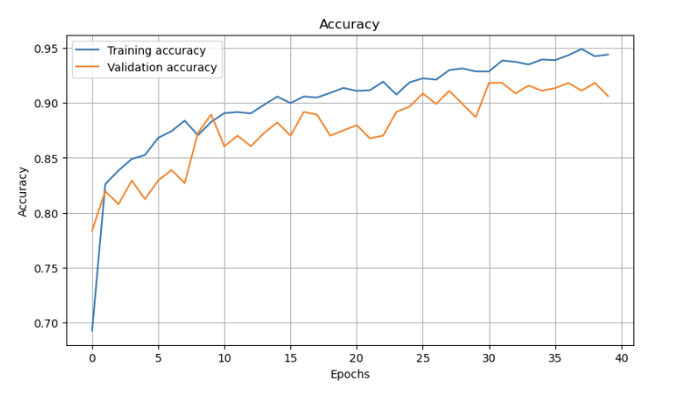
Related Work
Corn_&_Maize_Disease_Detection by MohankJha
92% Accuracy
Uses a CNN, alternating by convolutional layer to max pooling layer
Pretty simple base model

Slide 4


Dataset
https://www.kaggle.com/datasets/smaranjitghose/corn-or-maize-leaf-disease-dataset/data
0: Common Rust - 1306 images
1: Gray Leaf Spot - 574 images
2: Blight -1146 images
3: Healthy - 1162 images
Image size of 256x256
Batch size of 32

Slide 5

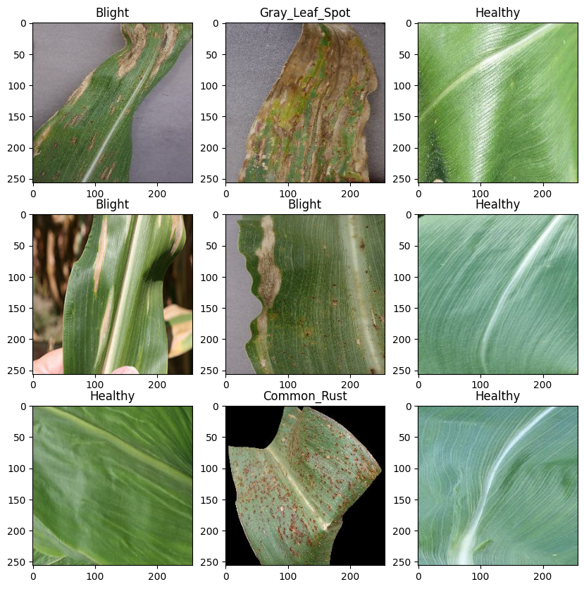

Preprocessing
Partitioned data: 70:20:10
Scaled down the RGB values to 0-1
Rescaled images to fit respective model

Slide 6


Method
Used Conv2 Layers, increasing the filter each time, followed by a max pooling layer
30 epochs
Import MobileNetV2 and leave it open
Add Flatten and Dense layers
100 epochs with early stopping

Slide 7
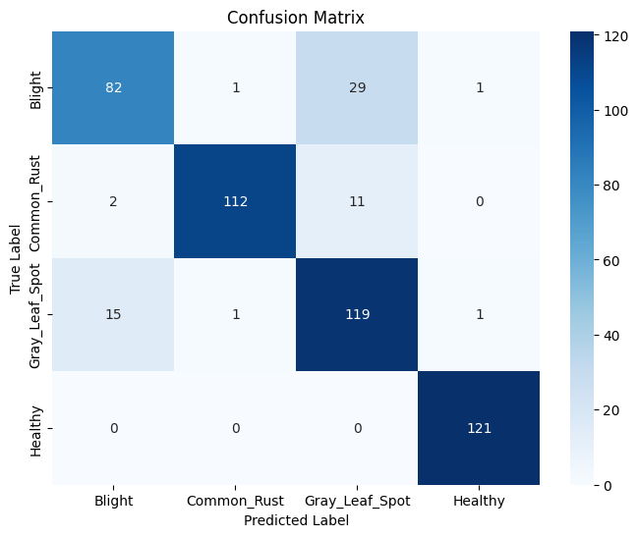
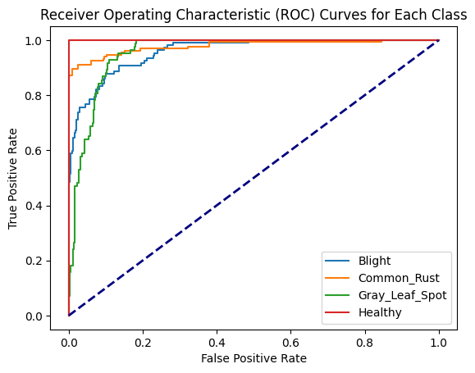
CNN: Accuracy 88%

Slide 8
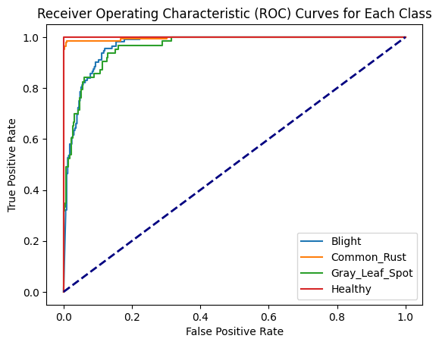
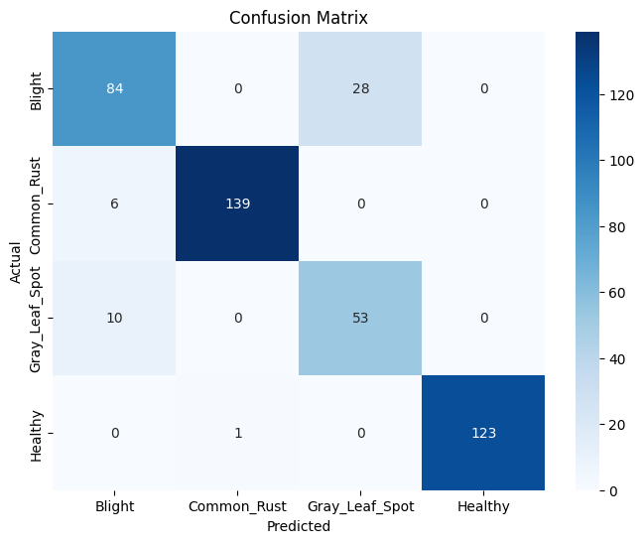
MobileNetV2: Accuracy 90%

Slide 9
Cited works and Contribution
Partner helped with proposal
Data:
https://www.kaggle.com/datasets/smaranjitghose/corn-or-maize-leaf-disease-dataset/data
Kaggle related work: https://www.kaggle.com/code/mohankjha/corn-maize-disease-detection
Singh, V.; Rees, M.; Hampton, S.; Annadurai, S. Plant Identification Using Convolution Neural Network and Vision Transformer-Based Models. Preprints 2023, 2023081330. https://doi.org/10.20944/preprints202308.1330.v1

